Slide 1
“Sharing with our neighbors God’s hope and love”
First UMC of Mabank
501 South Third Street Mabank, TX 75147 Phone: 903-887-3691 Fax: 903-887-0670 www.fumcmabank.com YouTube: FUMC Mabank
Rev. Dan Gurley

Slide 2
Today’s Altar Flowers:
In loving memory of Patsy Stedman.

Slide 3
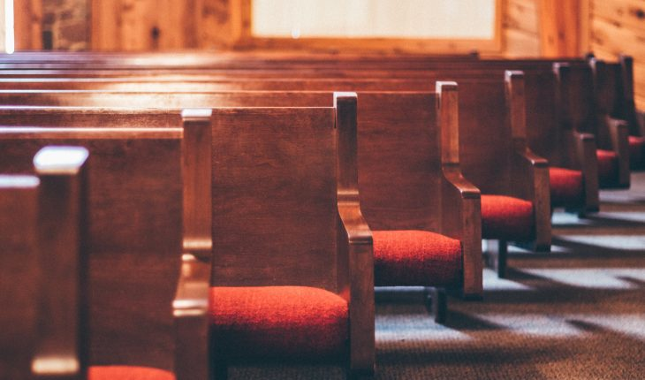
Announcements:

Slide 4
His Name Is Wonderful
His Name Is Wonderful
174
His name is wonderful, his name is wonderful, his name is wonderful, Jesus, my Lord.

Slide 5
He is the mighty King, Master of everything; his name is wonderful, Jesus, my Lord.

Slide 6
He’s the great Shepherd, the Rock of all ages, almighty God is he;
bow down before him, love and adore him, his name is wonderful, Jesus, my Lord.

Slide 7
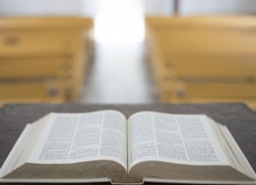
1 Peter 3:18-22
Today's Scripture Reading

Slide 8
There Is a Fountain Filled With Blood (1)
There Is a Fountain Filled with Blood
622
1. There is a fountain filled with blood drawn from Emmanuel’s veins;

Slide 9
and sinners plunged beneath that flood lose all their guilty stains.

Slide 10
Lose all their guilty stains, lose all their guilty stains; and sinners plunged beneath that flood lose all their guilty stains.

Slide 11
There Is a Fountain Filled With Blood (2)
2. The dying thief rejoiced to see that fountain in his day; and there may I, though vile as he, wash all my sins away.

Slide 12
Wash all my sins away, wash all my sins away; and there may I, though vile as he, wash all my sins away.

Slide 13
There Is a Fountain Filled With Blood (4)
4. E’er since, by faith, I saw the stream thy flowing wounds supply, redeeming love has been my theme and shall be till I die.

Slide 14
And shall be till I die, and shall be till I die; redeeming love has been my theme, and shall be till I die.

Slide 15
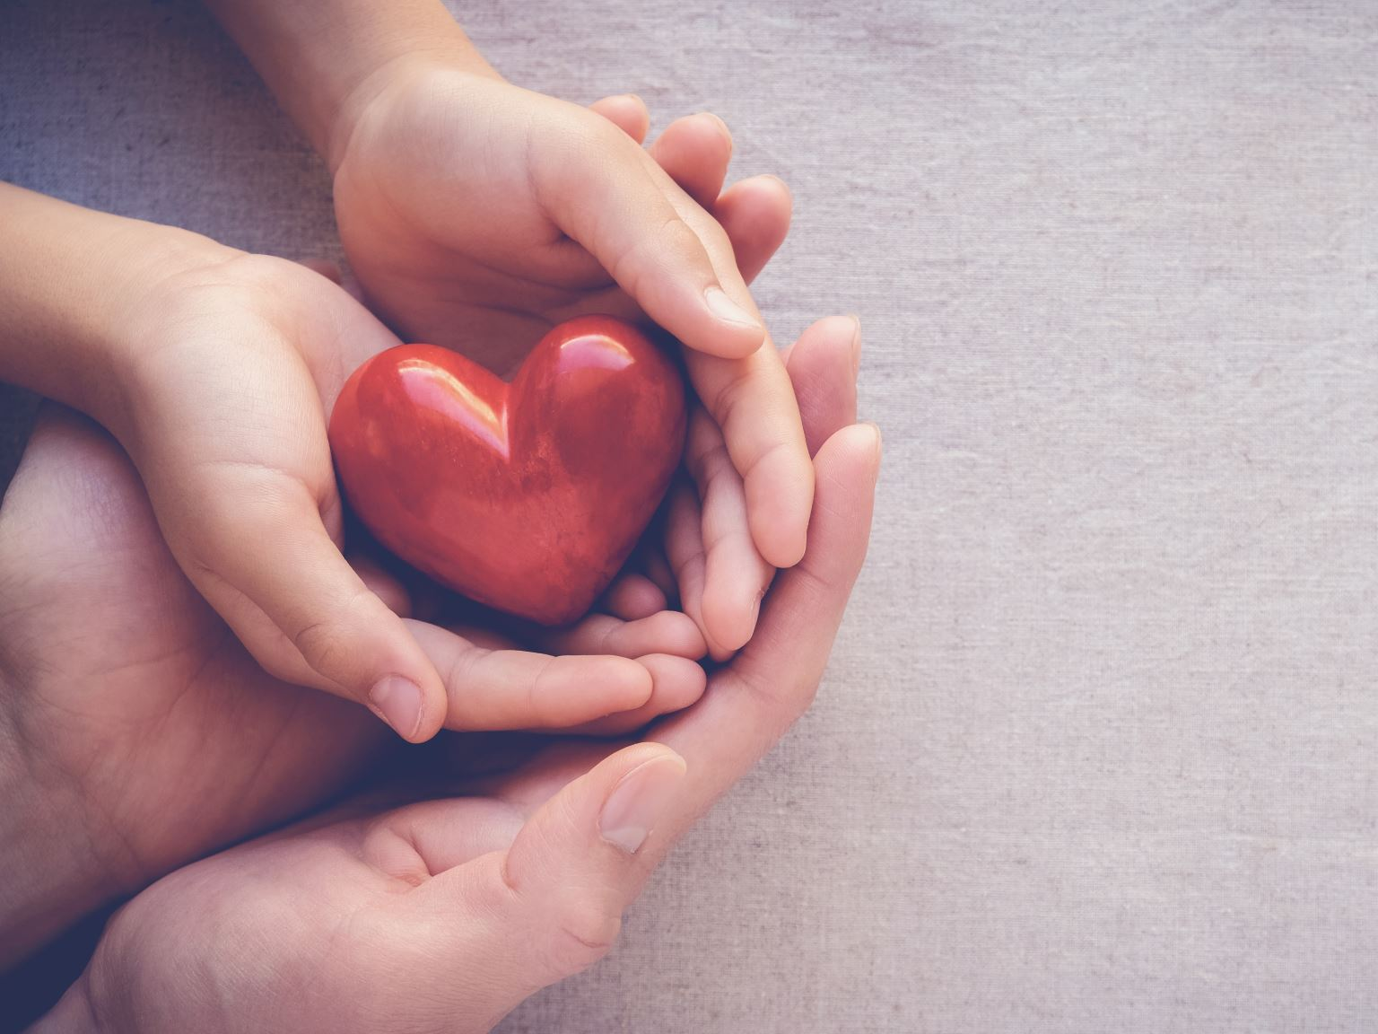
Offering
Tithe at Home: Visit FUMCMabank.com for more information.

Slide 16
Doxology
Praise God from whom all blessings flow,
Praise him all creatures here below,
Praise him above ye heavenly host,
Praise Father, Son and Holy Ghost.
Amen.

Slide 17
881
THE APOSTLES’ CREED TRADITIONAL VERSION
I believe in God the Father Almighty, maker of heaven and earth;

Slide 18
And in Jesus Christ his only Son our Lord: who was conceived by the Holy Spirit, born of the Virgin Mary, suffered under Pontius Pilate, was crucified, dead, and buried;

Slide 19
the third day he rose from the dead; he ascended into heaven, and sitteth at the right hand of God the Father Almighty; from thence he shall come to judge the quick and the dead.

Slide 20
I believe in the Holy Spirit, the holy catholic church, the communion of saints, the forgiveness of sins, the resurrection of the body, and the life everlasting. Amen.

Slide 21
Gloria Patri
Glory be to the Father
and to the Son
and to the Holy Ghost;
as it was in the beginning,
is now, and ever shall be,
world without end.
Amen. Amen

Slide 22
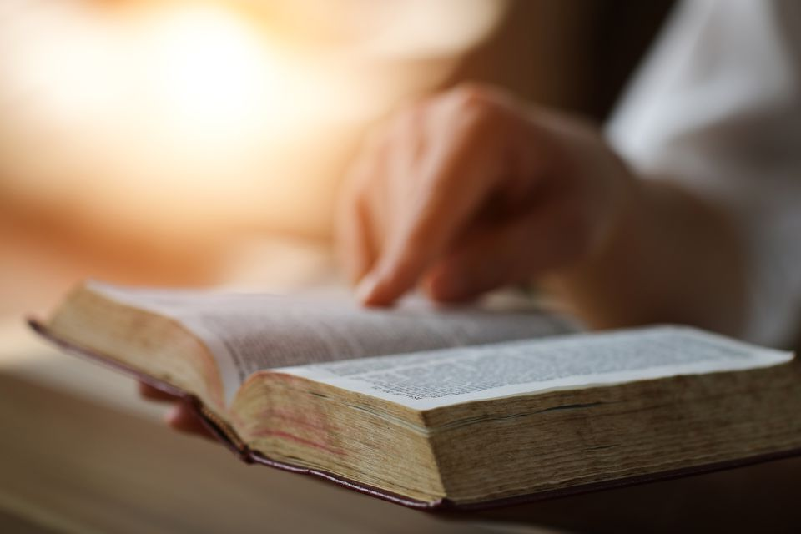
Pastor’s Pals

Slide 23
We’ll Understand It Better By and By (Verse 1)
We’ll Understand It Better By and By
525
1. We are tossed and driven on the restless sea of time; somber skies and howling tempests oft succeed a bright sunshine;

Slide 24
in that land of perfect day, when the mists have rolled away, we will understand it better by and by.

Slide 25
We’ll Understand It Better By and By (Refrain)
Refrain
By and by, when the morning comes, when the saints of God are gathered home,

Slide 26
we’ll tell the story how we’ve overcome, for we’ll understand it better by and by. (by and by)

Slide 27
We’ll Understand It Better By and By (Verse 3)
3. Trials dark on every hand, and we cannot understand all the ways that God would lead us to that blessed promised land;

Slide 28
but he guides us with his eye, and we’ll follow till we die, for we’ll understand it better by and by.

Slide 29
We’ll Understand It Better By and By (Refrain)
Refrain
By and by, when the morning comes, when the saints of God are gathered home,

Slide 30
we’ll tell the story how we’ve overcome, for we’ll understand it better by and by. (by and by)

Slide 31
We’ll Understand It Better By and By (Verse 4)
4. Temptations, hidden snares often take us unawares, and our hearts are made to bleed for a thoughtless word or deed;

Slide 32
and we wonder why the test when we try to do our best, but we’ll understand it better by and by.

Slide 33
We’ll Understand It Better By and By (Refrain)
Refrain
By and by, when the morning comes, when the saints of God are gathered home,

Slide 34
we’ll tell the story how we’ve overcome, for we’ll understand it better by and by. (by and by)

Slide 35
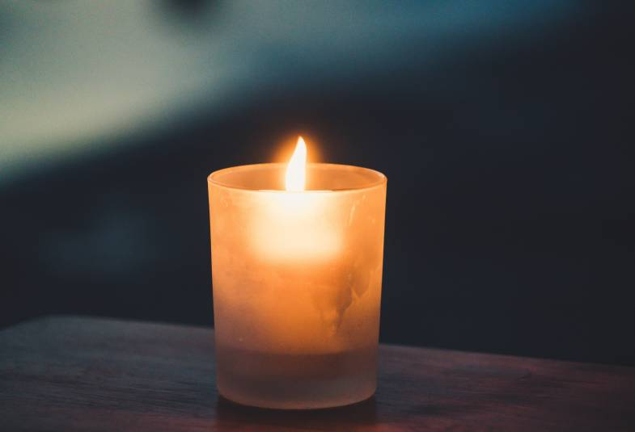
Pastoral
Prayer

Slide 36
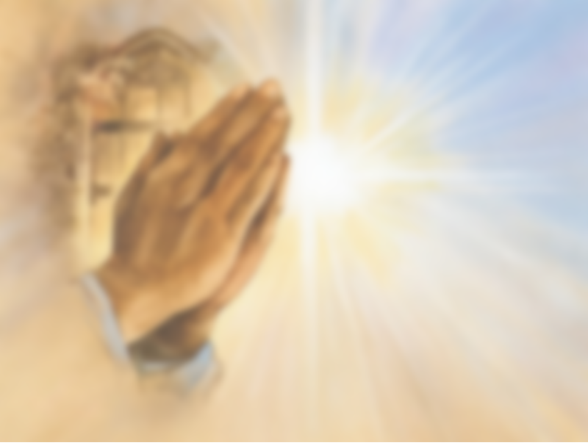
The Lord’s Prayer
Our Father, who art in heaven, hallowed be thy name.
Thy kingdom come,
Thy will be done on earth as it is in heaven.
Give us this day our daily bread.
And forgive us our trespasses,
As we forgive those who trespass against us.
And lead us not into temptation but deliver us from evil.
For thine is the kingdom,
And the power, and the glory, for ever. Amen.

Slide 37
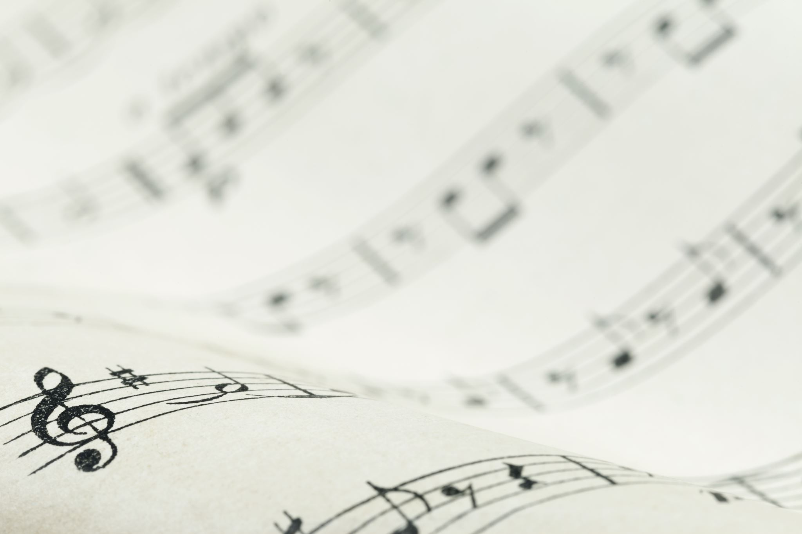
Special Music

Slide 38
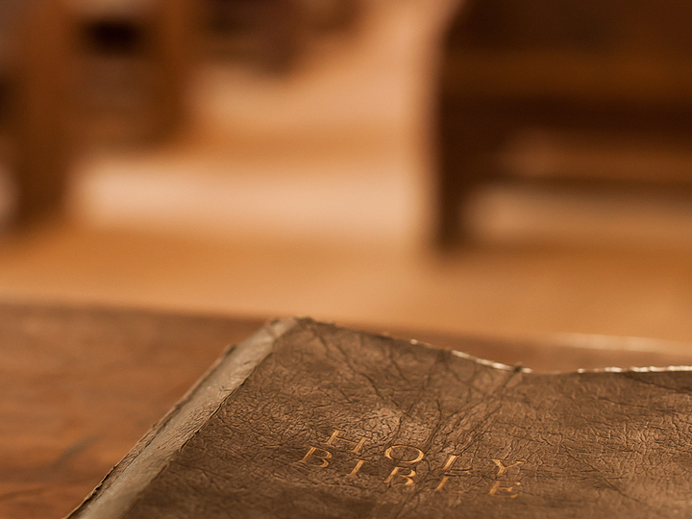
Today’s Scripture:
Mark 1:12-13
Rev. Dan Gurley

Slide 39
Today’s Sermon:
“Living in the Middle”
Rev. Dan Gurley

Slide 40
Turn Your Eyes upon Jesus
349
Turn Your Eyes upon Jesus
Turn your eyes upon Jesus, look full in his wonderful face, (wonderful face,)

Slide 41
and the things of earth will grow strangely dim in the light of his glory and grace.

Slide 42
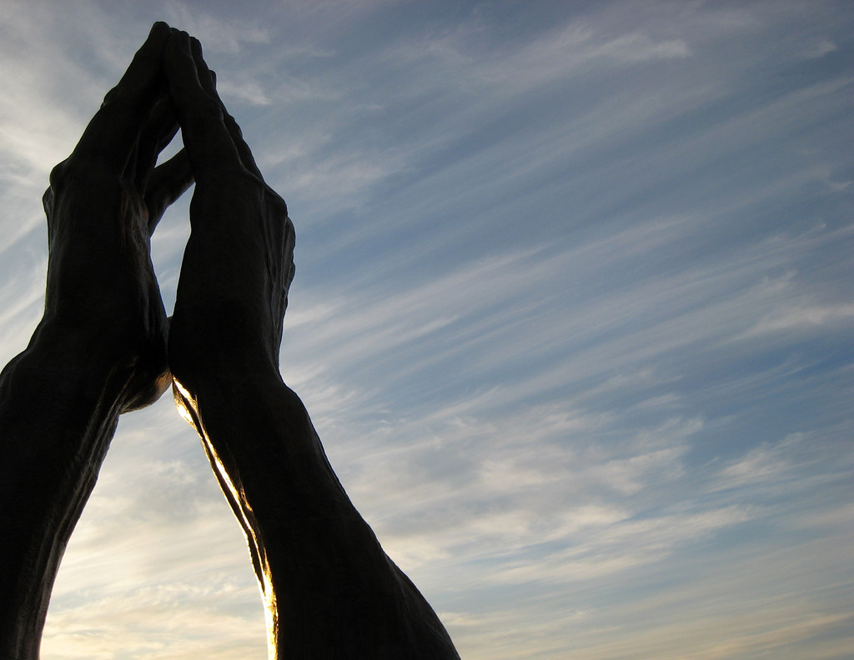
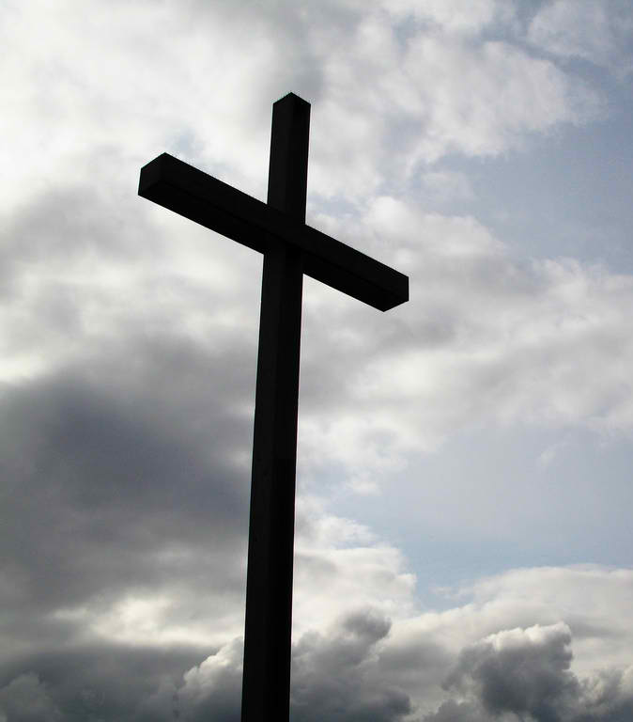
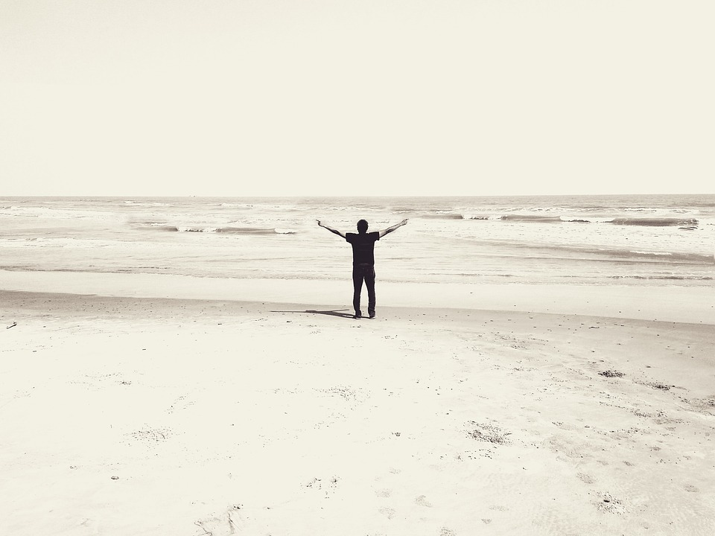
Benediction:
Rev. Dan Gurley

Slide 43
He Is Lord
177
He Is Lord
He is Lord, he is Lord! He is risen from the dead and he is Lord!
Every knee shall bow, every tongue confess that Jesus Christ is Lord.

